Slide 1
CTEK CS FREE
PODSTAWOWE INFORMACJE

Slide 2
CS FREE
PRZENOŚNE ŁADOWANIE
GDZIEKOLWIEK JESTEŚ​
NAŁADUJ JE.
ZABIERZ ZE SOBĄ.
UŻYJ GDZIEKOLWIEK.

Slide 3
CS FREE
Pierwsza prawdziwie przenośna ładowarka bez konieczności podłączania do gniazda sieciowego
Jeśli twój akumulator jest pusty, Adaptive Boost znajdzie najszybszy i najbezpieczniejszy sposób aby w 15 minut doładować go i pozwolić Ci wrócić na trasę.
Notes:
For the once saying this is an expensive booster, it is important to know that This is not just boosting, it is adaptiv boosting
And it is not only an Adaptive Booster, it is a charger and a maintainer – and the only truly portable charger on the market! We are world leading again!
Portable – as meaning that you can use it everywhere – with our without any energy source connected to it.
We all know how a traditional booster works, it will transfere a huge amount of energy to the recieving battery to chock it to start
When clamped to the battery terminals the jump starter transfers its peak amperage to the battery and "boosts" the cranking amps of the battery.
The high peak amperage risk damaging the electronics in the vehicle.
No charge! When the car is started – the job is done!
Lets see what the CS FREE do
It will gently meet the recieving batteries state of charge and use the Combined charge curve for a safe increase of the energy.
If all energy is not used to get the car ready to start, it will keep charging the battery until the internal battery is out of energy.
– cause there is no difference between Adaptiv boost and charging – it follows the same curve.
And it is good for all types of 12V batteries – lead acid and Lithium Iron phosphate
As all CTEK chargers – it is electronic safe, spark free and reverce polarity protected.
AND Beside of being an Adaptive Booster
It is a charger
And a Maintainer
And a cordless portabe charger
And a power bank!
All you need to do with your batteries is summoned up in this black box.

Slide 4
“Ten ekscytujący nowy produkt naprawdę Cię wyzwoli!
Nie ważne gdzie jesteś – CS FREE
naładuje Twój akumulator
albo
Doładuje kompletnie pusty – w szybki i bezpieczny sposób.
Nieważne czy jesteś w domu czy w drodze.”
Jonas Berglund, Manager Produktu, CTEK

Slide 5
PRZENOŚNE ŁADOWANIE AKUMULATORA 12V (bez zasilania z gniazdka)
Podłącz odłączany kabel zaciskowy DC do CS FREE
Podłącz kabel zaciskowy DC do CS FREE
Połącz zaciski DC do akumulatora (zgodnie z wytycznymi producenta)
Główny wyświetlacz LED pokaże ile zostało czasu do pełnego naładowania akumulatora (maksymalny prąd ładowania to 20A)
Notes:
Let me tell you some scenarios
Ian knows that todays cars got a lot of electronic components that need energy even when the car is parked.
He clearly see the need of charging
Problem is that Ian lives in an apartment and there are no wall socket available to charge from.
With the CS FREE, he can charge cordless. Just connect the charger, hide it under the bonnet – and disconnect when it is time to go, and recharge the CS FREE through wall socket or through the 12 V socket in the car and it is ready to use when needed again

Slide 6
TECHNOLOGIA ADAPTIVE BOOST
DOŁADOWUJE PUSTY AKUMULATOR W 15 MINUT
Automatycznie analizuje stan akumulatora
Znajduje najbezpieczniejszy sposób przywrócenia sprawności akumulatora
W przeciwieństwie do innych urządzeń rozruchowych CS FREE bierze pod uwagę stan akumulatora
Zapewnia mu ładunek potrzebny do rozpoczęcia pracy
Pozwala uniknąć uszkodzenia akumulatora i podzespołów elektronicznych w pojeździe.
Notes:
David finishes work after a long day. He is in a hurry to get home to a family dinner. He leaves the office gets to his car and finds that it won’t start due a flat battery.
Instead of calling the road assistance company he reaches for CS FREE in the glovebox.
He connect it to the recommended charge points starts it up , calls his family to tell them he will be late – 15 minutes later he starts the car to go home.
When David has started the car he connect the CS FREE to the cig output to make sure it is fully charged when he needs it again. When fully charged it can be kept in the glovebox for a year and still work.

Slide 7
PRZYGODA: Dwu TYGODNIowy KEMPING Z RODZINĄ
Podłącz kabel do to CS FREE
Połącz CS FREE do gniazda zasilania za pomocą ładowarki sieciowej z kablem USB albo:
60W opcjonalnym zestawem do ładowania za pomocą panelu solarnego.
Podłącz kable DC do akumulatora (zgodnie z wytycznymi producenta)
CS FREE dostarczy prąd 5A
Główny wyświetlacz LED pokaże czas do pełnego naładowania urządzenia
Porty USB-C USB-A do ładowania laptopów, smartfonów, tabletów, zegarków i kamer, bez dostępu do gniazda sieciowego.
Notes:
The family are out and about for a weekend break or away on vacation.
They find the perfect spot to hike. Good fishing, nice beaches.
But they need to keep the RV charged up.
The CS FREE together with the SOLAR PANEL CHARGE KIT will make sure the battery is kept charged.
The CS FREE will also make sure all the phones, cameras, computers and so on can be charged wherever needed.
With a fully charged CS FREE – you are always sure you can start the vehicle and get home!
,You can still charge and maintain your vehicle battery anywhere you go – even if CS FREE’s internal battery is empty.
There are some really smart accessories to use, and we will talk about those later on.

Slide 8
ŁADOWANIE I KONSERWACJA AKUMULATORA 12V (z pomocą źródła zasilania)
PODŁĄCZ ZACISKI DC do CS FREE
Podłącz CS FREE do gniazda sieciowego za pomocą ładowarki sieciowej z kablem USB-C albo:
12V akumulatora serwisowego z opcjonalnymi zaciskami kabla ładowania USB-C
60W opcjonalnym zestawem do ładowania za pomocą panelu solarnego
Podłącz kable DC do akumulatora (zgodnie z wytycznymi producenta)
CS FREE dostarczy prąd do 5A
Główny wyświetlacz LED pokaże czas do pełnego naładowania urządzenia
Zachowaj połączenie aby uzyskać ładowanie podtrzymujące
Notes:
The CS FREE can be used as a common charger,.
Just connect the PD cahrger, the charge clamps, the 60W solar paneln or the 12V cig plug.
Attach the battery clamps to the battery you want to charge – and you have a 5A charger with a combo curve that will charge your 12V batteries no matter of what type.

Slide 9
ŁADOWANIE BATERII WEWNETRZNEJ.
PODŁĄCZ WEJŚCIE ZASILANIA CS FREE’S USB-C DO:
Gniazda sieciowego za pomocą ładowarki sieciowej z kablem USB-C lub:
12V akumulatora serwisowego z opcjonalnymi zaciskami kabla ładowania USB-C
60W opcjonalnym zestawem do ładowania za pomocą panelu solarnego
Kabel do ładowania USB-C z wtyczką 12V
Czas ładowania urządzenia: 1 godzina
Diody wokół przycisku „ON” pokazują stan naładowania urządzenia
Notes:
If you want to use the charger as a cordless portable charger you need to make sure the internal battery is fully charged.
This could be done the same way as when you uses the charger as a traditional cahrger with input and output.
Charge the internal battery:
Internal battery takes less than an hour to fully charge through the unit’s fast USB-C input and can be charged using:
the supplied PD travel charger with plug adaptors for different types of power outlet;
a service battery using the optional CTEK USB-C cable clamps;
the vehicle’s 12V cigarette lighter/accessory socket using the optional CTEK USB-C Cig Plug cable;
a 60W solar panel connected using an MC4 to USB-C cable.
Internal battery, when fully charged, will hold its charge for up to a year, making it ideal for keeping stored in the vehicle for when you need it.

Slide 10
KLUCZOWE FUNKCJE
Przenośne urządzenie które możesz zabrać wszędzie bez konieczności podłączania go do gniazdka elektrycznego
Adaptive Boost - bezpieczne doładowanie pustego akumulatora w ciągu 15 minut
Łatwe i bezpieczne w użyciu. Całkowicie automatyczne
W pełni naładowana bateria wewnętrzna utrzymuje swoją moc przez rok
Może być ładowane i zasilane energią słoneczną lub 12V w przypadku długiego ładowania konserwacyjnego
Obsługuje wszystkie typy akumulatorów kwasowo-ołowiowych i litowych 12V
Wskazuje czas pozostały do pełnego naładowania
Porty USB-C i USB-A do ładowania laptopów, smartfonów, tabletów i innych urządzeń
Notes:
I will walk you through the USPs, starting with the Portable charging you can take anywhere
The CS FREE frees you up so you’re no longer tied to a power outlet if you need to charge your vehicle’s battery.
Once the CS FREE’s internal battery is fully charged, it’s ready to go and you can take it with you wherever you’re heading. And it doesn’t need to be connected to – or anywhere near – a power outlet again for up to a year, or until it needs recharging after being used.
The CS FREE works with or without connection to a power outlet, whether you’re adaptively boosting, charging or maintaining your vehicle battery.
CS FREE unplugged: Adaptive boost give the battery exactly what it needs. Delivers up to 20A charge to charge battery as quickly as possible. If left connected to the vehicle, once the battery is fully charged it will move over to maintenance stages.
CS FREE connected to power socket, 12V battery or solar panel delivers up to 5A. If left connected to the vehicle, once the battery is fully charged it will move over to maintenance stages.
·If your battery’s flat, the CS FREE’s revolutionary Adaptive Boost technology will automatically analyse the state of the battery it’s connected to, automatically adjust to the battery’s voltage level and then work out the safest and most effective way of giving it enough power to start your vehicle. What’s more, this will only take up to 15 minutes. ​
·Unlike most ‘boosters’ and jump lead starting, the CS FREE is sensitive to the state of the battery and only gives it the charge it needs to get you started. This avoids the possibility of any damage to the battery itself or your vehicle’s electronics.​
​
​
·Portable, smart, safe and worry-free Adaptive Boosting, charging and maintaining for vehicle batteries and personal tech products, wherever you are. With our without connected cords.​
·​
​
​
The CS FREE can charge all types of lead-acid or lithium battery.(LiFePO4)​
​
​
·No modes, it’s fully automatic. Simply turn it on and leave the CS FREE to do the rest. Just a clear, easy to read display.​
·​
·And we will look into the MMi later on in this presentation​
​
​
Shows you how long there is left before your battery is fully charged.​
​
New model, new shape to make it easily portable. You can safely store it in your vehicle so it’s always ready when you need it.​
​
USB-C and USB-A outputs for charging laptops, smartphones, tablets, watches and cameras, even when the CS FREE is not connected to a power outlet.​
​
When fully charged, it can be left on the shelf for a year, and still work as good!​

Slide 11
CS FREE ZAWARTOŚĆ ZESTAWU
W PUDEŁKU
Ładowarka sieciowa
Adaptery sieciowe EU, UK i US
Kabel USB-C do USB-C długości 1m
Odłączany kabel zaciskowy DC o długości 2m
Instrukcja obsługi.
Notes:
Note! The US adapter are in the box but we dont have the certificates to sell to US

Slide 12
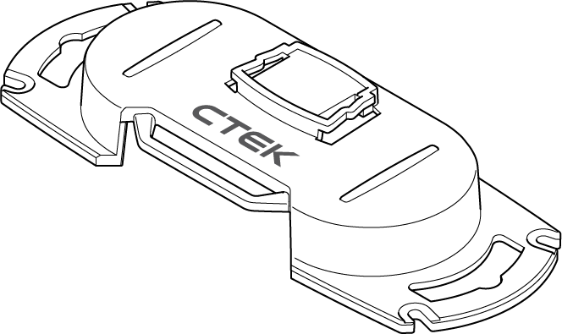
CS FREE AKCESORIA
OPCJONALNE
Kabel USB-C z wtyczką do gniazda zapalniczki 12V
Kabel z zaciskami z wtyczką USB-C
Zestaw ładowania z panelem solarnym
Uchwyt ścienny z funkcją blokady wsunięcia
Torba do przechowywania urządzenia.
Notes:
USB-C charge cable 12V accessory plug: to charge up the CS FREE internal battery via the vehicle 12V accessory socket
USB-C charge cable clamps: to power the CS FREE via a separate 12V 'service' battery
Solar panel charge kit: to power the CS FREE via solar power
CS Wall Mount with slide-lock function: for practical storage, quick and easy access to the CS FREE
Storage bag: for safe storage and transportation of the CS FREE

Slide 13
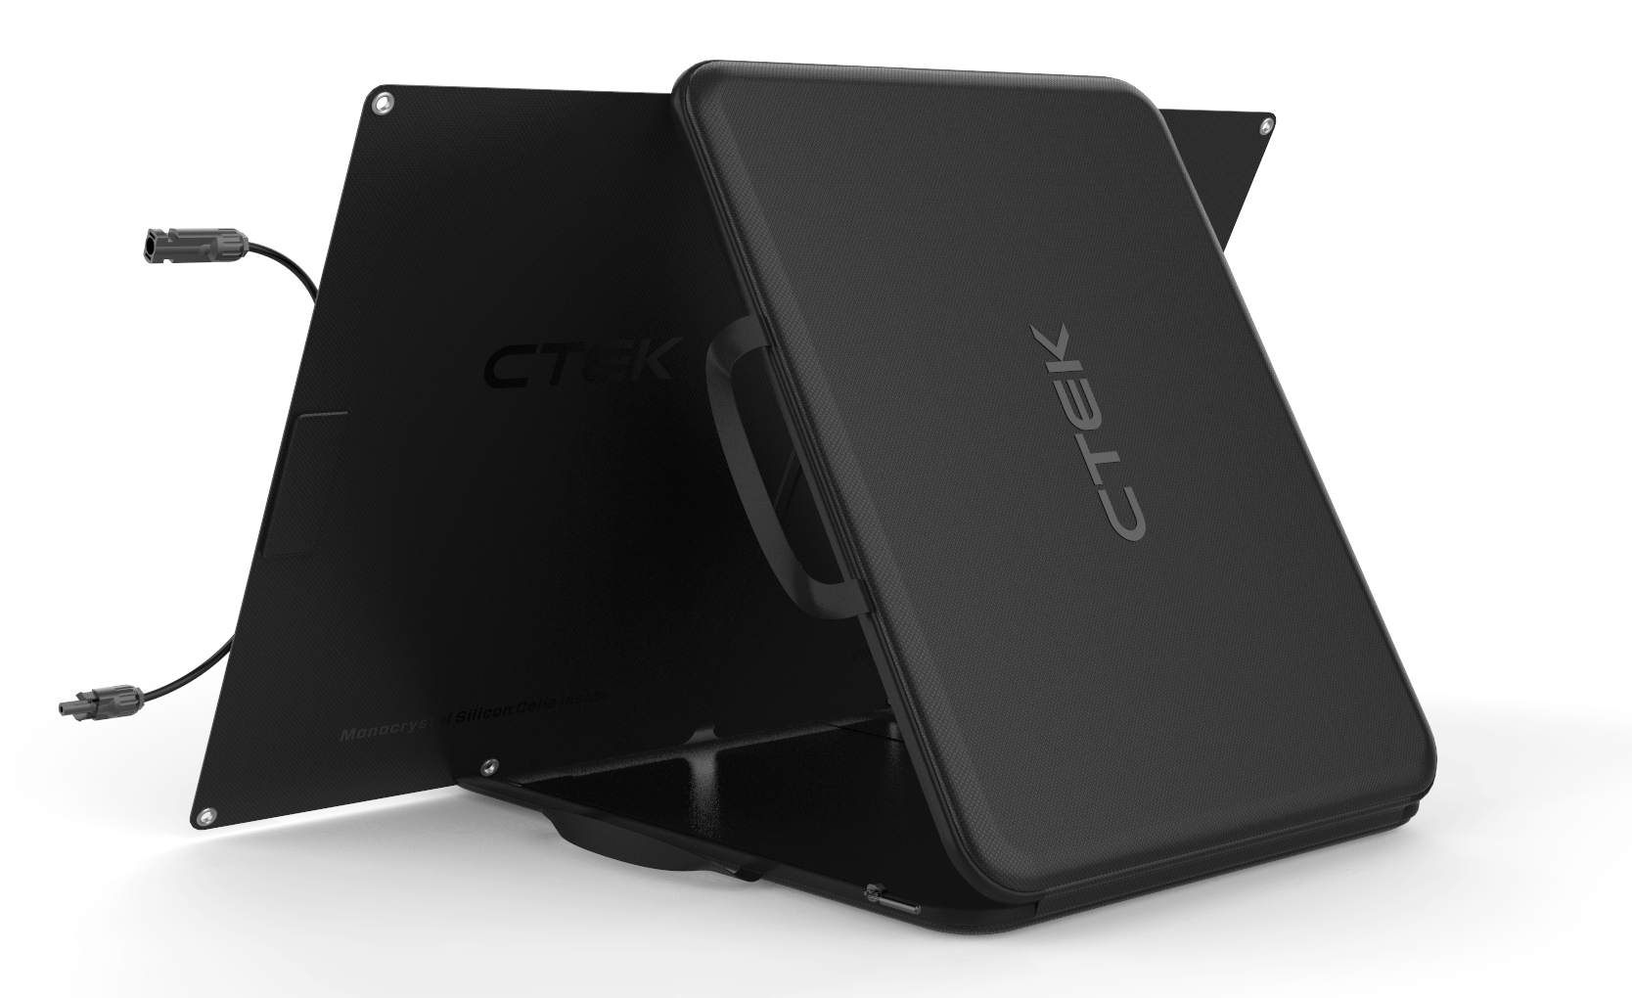
CS FREE ZESTAW Z PANELEM SOLARNYM
Wykorzystuje wodoodporny port MC4, dzięki czemu można zanurzyć panel w wodzie na maksymalnie 30 minut bez szkodliwego wpływu na produkt.
Klasa odporności IP67.
Safety Box ograniczający napięcie i prąd generowany przez panel solarny aby zapobiec nadmiernemu napięciu i szkodzeniu urządzeń.
Etui pełni również funkcję podpórki. Służy do regulacji kąta padania słońca w zakresie 0-180 stopni.
Miejsca na haczyki– pozwalają zawiesić panel na każdej z czterech stron.
Pasek antypoślizgowy – zapobiega przesuwaniu się urządzenia.
Notes:
I recommend you to test the solar panel at first occation.
It is extremly robust and waterproof for 30 minutes, It is easy to place and the 4 meter long cable makes it possible to have the panel far away from the battery.
The casing can easily be used to get the perfect angle to the sun
The CS FREE is a DC charger so no regulator is needed – it is already built into the system.
And as one of our younger test persons said – now you can charge your phones and devices totally CO2 FREE!

Slide 14
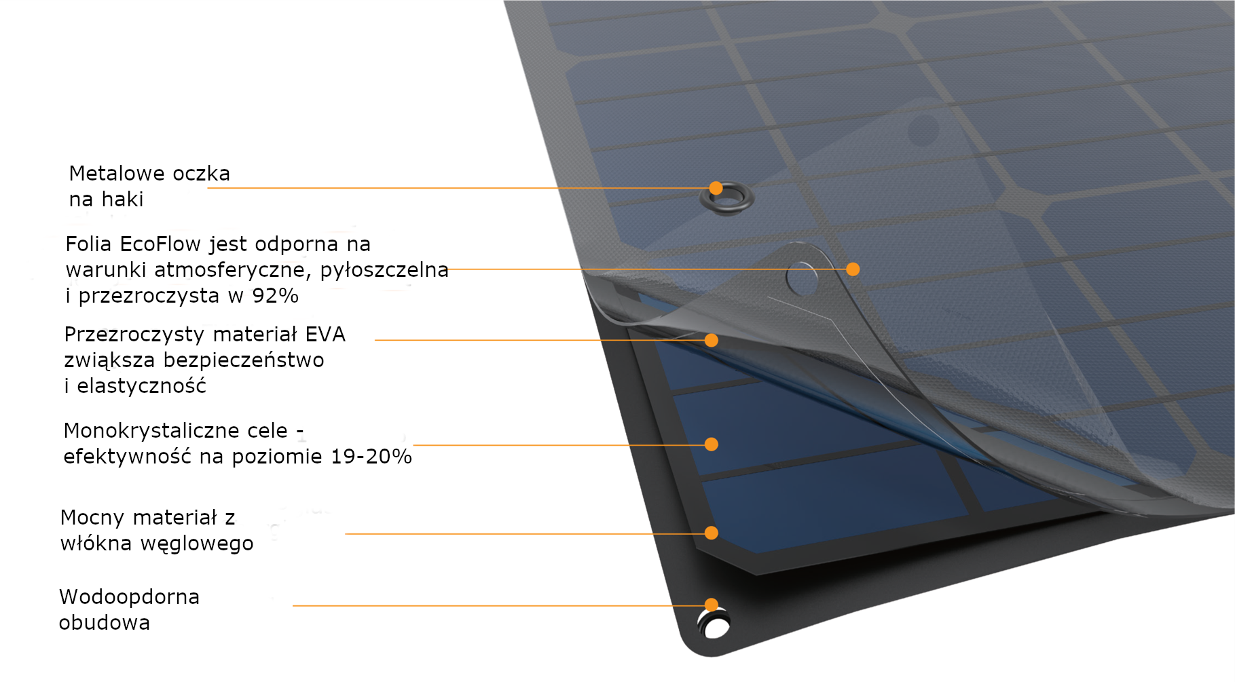
ZINTEGROWANY PROCES LAMINOWANIA
Notes:
The high quality solar panel is environmentally friendly and gives you clean, renewable energy.
It also gives you the ultimate freedom by freeing yourself from the restrictions and costs that come with connecting to the mains.

Slide 15
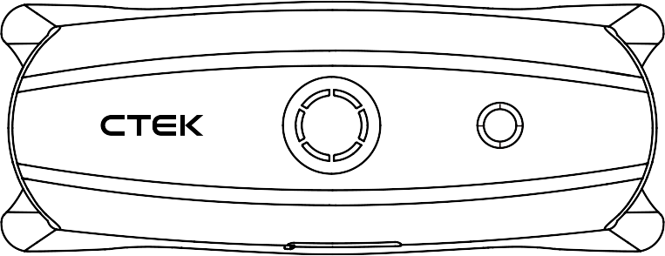
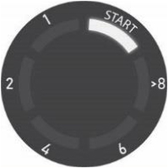
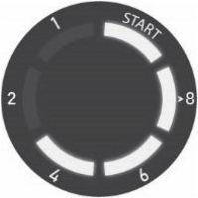
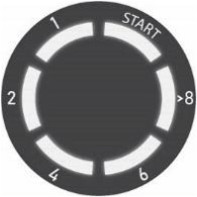
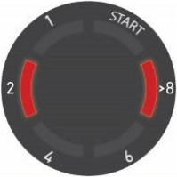
ŁATWA W UŻYCIU
Notes:
If we look at the charger we can se two MMIs on the top.
The small one is also the ON/OFF button and this MMI will show you the state of charge of the internal battery.
The bigger MMI will show the status of the exernal battery.
To the left there is an input, and to the right there is an output.
There is also outputs on the side of the charger.
I will talk a bit about the MMI, but as pictures are not as good as the real thing, we will look deaper into the MMI later in the hands on session​
It has been some people testing the product – and really good news is that almost all of them say that the MMI is very intuitive.​
The smaller one, which is also the start button, will show you the state of charge of the INTERNAL battery​
Internal Battery Level 0-10%​
• Internal Battery Level 10-25%​
• Internal Battery Level 25-50%​
• Internal Battery Level 50-75%​
• Internal Battery Level 75-100%​
The bigger MMI, will show you how charged the external battery is. When the first led "START" is lit – you will most likey have power enough to start your car.​
I say – Most likey – because as usual – we can save most of the batteries, but not raise the ded or the once close to its end.​
You will be able to see – and follow the external batteries State of Charge by following the leds in the circle and it will count down in hours how long time is left before fully charged.​
If somethings goes wrong – reversed connected, a broken battery or a too big battery or too many consumers active – there will be two steady red lights shown on the big MMI.​
Good to know is – that if the charger itselfe is broken, it will go black. Quite understandable – the user cant mend it – so it is better it will be returned to the dealer as faulty.​
​

Slide 16
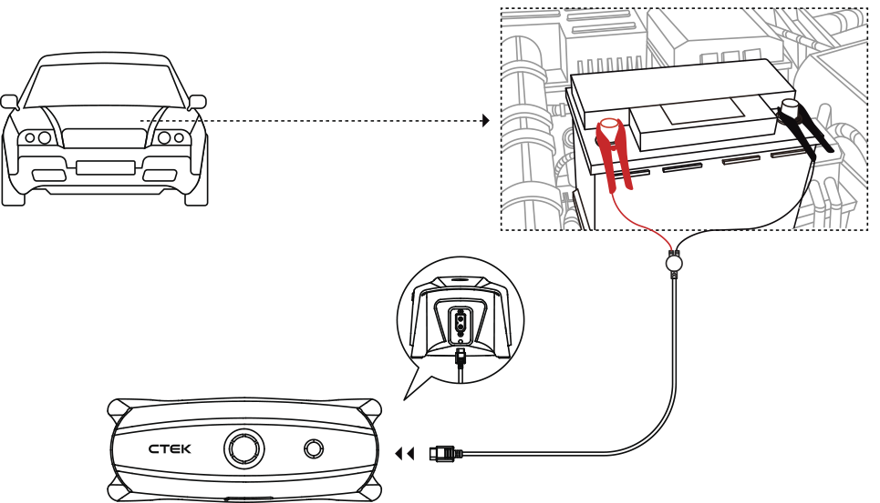
JAK PODŁĄCZYĆ URZĄDZENIE
Notes:
If the battery clamps on the ”output” side is connected, but nothing on the inside - the charger will work as AN ADAPTIVE BOOSTER, cordless and with up 20A charge.
As smart as any CTEK charger, it analyzes the battery and start to boost in a safe way, using the COMBINED CHARGE CURVE for both lead acid and lithium.
If the battery is not in an extremly poor condition the car will start within 15 minutes - The first led on the big MMI will show a steady light when ready to go.
If you don’t need the ADAPTIVE BOOSTER, you can cordlessly use it as a portable charger and maintainer, as long as there is power left in the internal battery.
The state of charge of the internal battery is shown in the small circel. All leds lit – a fully charged 66Wa battery. When the last led starts to flicker there is less than 10% left in the internal battery. And it will soon close down.

Slide 17
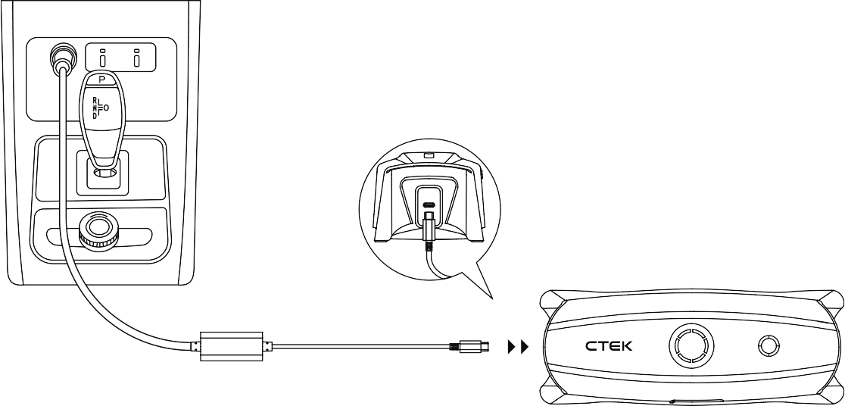
JAK ŁADOWAĆ BATERIĘ WEWNĘTRZNĄ Z POMOCĄ KABLA USB-C Z WTYCZKĄ DO GNIAZDA ZAPALNICZKI 12V
Notes:
If you connect to input side and the out put side , it will work as a 5 A charger, charging both lead acid and lithium iron phosphate with any of the smart accessories..
If you connect only to the IN side – the internal battery will be charged.
USB-C charge cable 12V accessory plug – really smart if you have used the CS FREE and you need to recharge. Just take it with you in the car – connect to the 12V plug and the internal battery will be charged, if you park the car before the internal battery is fully charged – no problem it will keep charging the next time you start the car.
When fully charged you can leave the CS FREE in the glovebox for a year and it will still work perfect

Slide 18
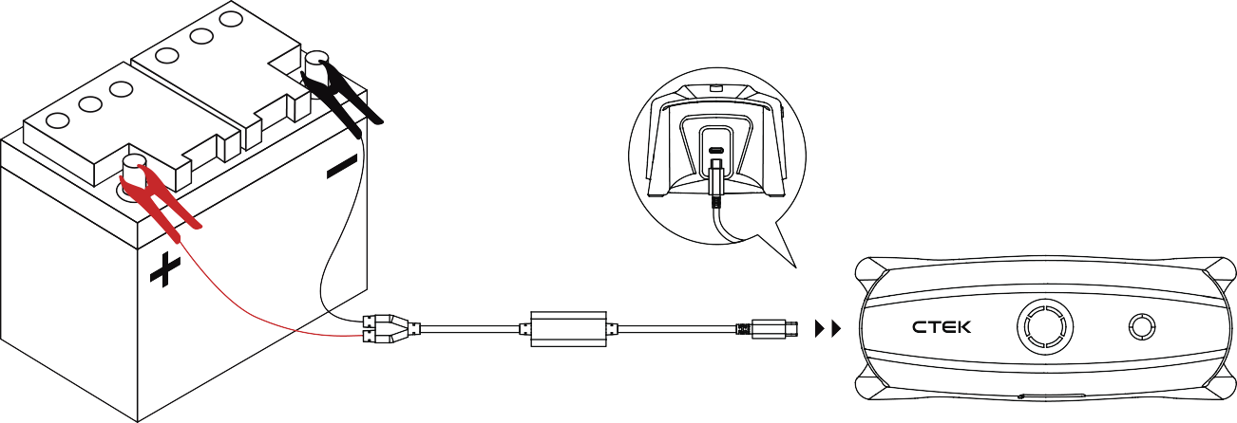
JAK ŁADOWAĆ BATERIĘ WEWNĘTRZNĄ KABLA USB-C Z ZACISKAMI
Notes:
You can also charge from a battery via the USB-C charge cable clamps .
This is a good solution if you want to charge from a stand alone battery, of from the batteries in a solar panel system, the level is 10-25V so it is not recommended to use a 24V system to charge from.

Slide 19
JAK ŁADOWAĆ BATERIĘ WEWNĘTRZNĄ Z POMOCĄ ZESTAWU Z PANELEM SOLARNYM
Notes:
Solar panel charge kit with a 4 m long cable, with the regulatero built into the system.
Good to know is that the charger will always prioritize the external battery. When there is power left overs – the internal battery will be charged.

Slide 20
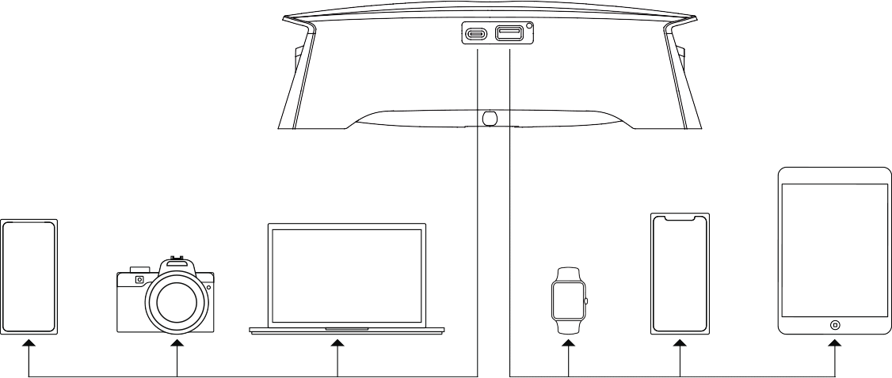
JAK ŁADOWAC GADŻETY
Notes:
From the USB C and the USB A output you can charge all the smart devices we have around us. This outlet can be used with or without any input, and also at the same time as you are charging your car – just remember that the external battery always is prioritized.

Slide 21
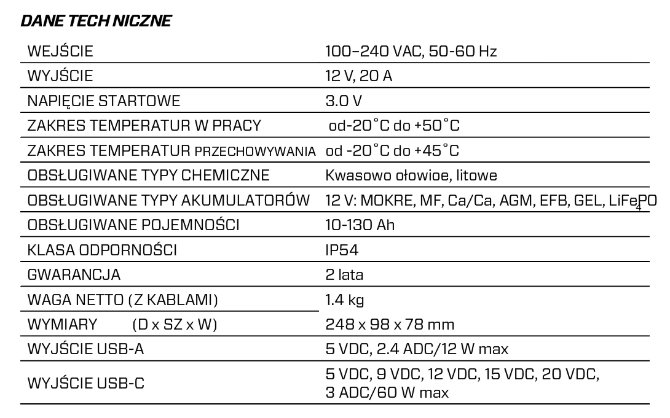
SPECYFIKACJA TECHNICZNA
Notes:
The specification contains a good portion of information – but I think you all can read and understand this, so I will leave this slide.

Slide 22
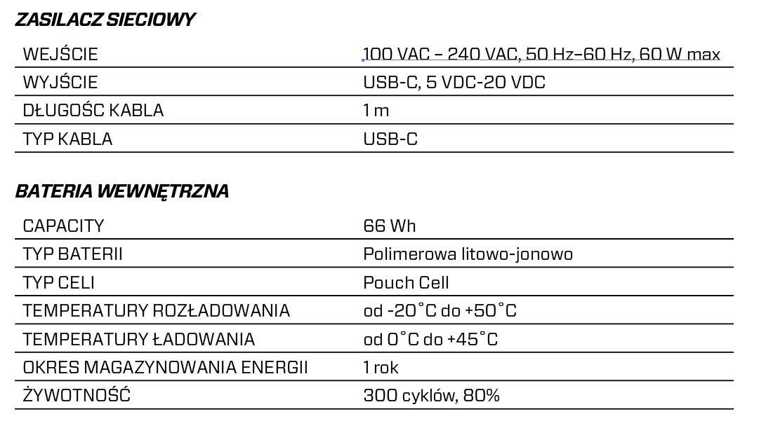
SPECYFIKACJA TECHNICZNA
Notes:
The CS FREE is the first CTEK product with an internal battery, so lets talk about that!
Good to know – the 66Wh is, from what we know, the stronges battery in comprable products. We have found a compettitor with 55wh – but that product can not be called a portable charger or a adaptive booster.
The battery is a lithium- Ion Polymer – battery,
I can't really host a training and not give you even a tiny bit of battery knowledge.
CTEK usually charge Lithium Iron Phosphate, wich should not be mixed up with lithium ION! Lithium ION has got a higher energy density and is perfect for power hungry electronics.
The LiFePO4 on the other hand has a lower energy density but works so much better at higher temperatures, and the discharge rate doesn't significantly degrade the lithium Iron Posphate as the capacity reduces
.
Lithium-ion battery: Rechargeable battery with cobalt, manganese, nickel and/or other metals as cathode and with a graphite anode.
Lithium-ion polymer battery: Similar to Li ion with a solid polymer as electrolyt, the addition of gelled material promotes conductivity.
Do not mix up the Lithium-ion polymer with the
Lithium polymer battery: Also known as solid-state battery; they uses solid polymer as electrolyte; the heat induces conductivity. (är anledningen till ökad ledningsförmåga) The LiPo is often used in power tools and computers.
The pouch cell offers a simple, flexible and lightweight solution to battery design. Exposure to high humidity and hot temperature can shorten service life. The pouch cell makes the most efficient use of space and achieves a 90 to 95 percent packaging efficiency, the highest among battery packs.
And perhaps a more usable knowledge – the internal battery needs less than one hour to get fully charged.

